Slide 1
The pull request model
What is a pull request in Git? A pull request is an event in Git where a contributor asks a maintainer of a Git repository to review code they want to merge into a project.
Pull requests let you tell others about changes you've pushed to a GitHub repository. Once a pull request is sent, interested parties can review the set of changes, discuss potential modifications, and even push follow-up commits if necessary.
Pull Requests are commonly used by teams and organizations collaborating using the Shared Repository Model, where everyone shares a single repository and topic branches are used to develop features and isolate changes.
Many open source projects on GitHub use pull requests to manage changes from contributors as they are useful in providing a way to notify project maintainers about changes one has made and in initiating code review and general discussion about a set of changes before being merged into the main branch.
Git Pull Request Approval process:-
The process for a pull request approval in Git will involve getting the project maintainer(s) to review your work; after which they will provide comments or, if your pull request is approved, will merge your changes directly into the main repository.

Slide 2
Pull requests let you tell others about changes you've pushed to a branch in a repository on GitHub. Once a pull request is opened, you can discuss and review the potential changes with collaborators and add follow-up commits before your changes are merged into the base branch.
Pull request is a process for a developer to notify team members that they have completed a feature. Once their feature branch is ready, the developer files a pull request via their remote server account. Pull request announces all the team members that they need to review the code and merge it into the master branch.
The "git pull" command
The pull command is used to access the changes (commits)from a remote repository to the local repository. It updates the local branches with the remote-tracking branches. Remote tracking branches are branches that have been set up to push and pull from the remote repository. Generally, it is a collection of the fetch and merges command. First, it fetches the changes from remote and combined them with the local repository.
The term pull is used to receive data from GitHub. It fetches and merges changes from the remote server to your working directory. The git pull command is used to pull a repository

Slide 3
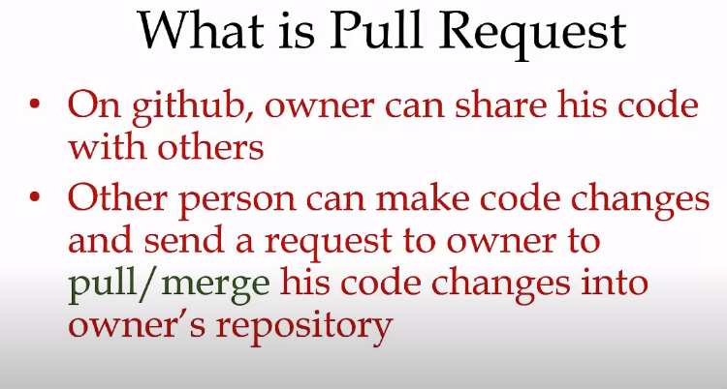

Slide 4
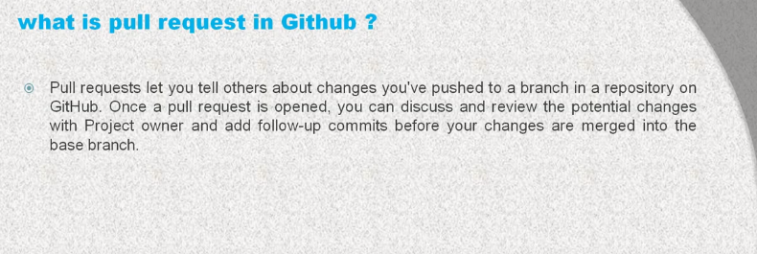

Slide 5
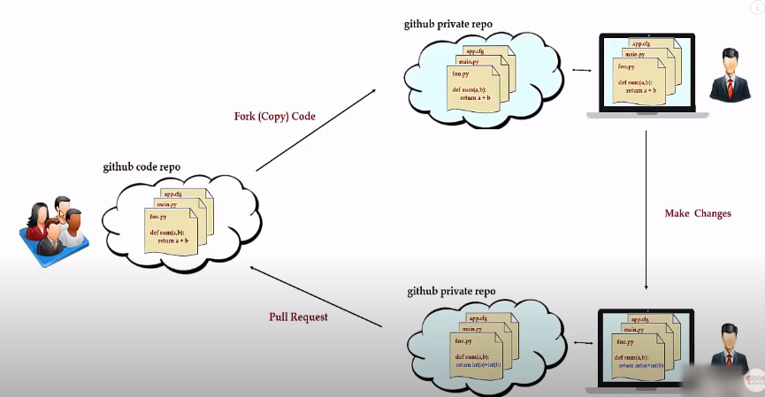
How does a Pull request work

Slide 6
Creating a Pull Request
There are 2 main work flows when dealing with pull requests:
Pull Request from a forked repository
Pull Request from a branch within a repository
When working with pull requests, keep the following in mind:
If you're working in the shared repository model, we recommend that you use a topic branch for your pull request. While you can send pull requests from any branch or commit, with a topic branch you can push follow-up commits if you need to update your proposed changes.
When pushing commits to a pull request, don't force push. Force pushing can corrupt your pull request.
After initializing a pull request, you'll see a review page that shows a high-level overview of the changes between your branch (the compare branch) and the repository's base branch. You can add a summary of the proposed changes, review the changes made by commits, add labels, milestones, and assignees, and @mention individual contributors or teams. For more information, see "Creating a pull request.“
Once you've created a pull request, you can push commits from your topic branch to add them to your existing pull request. These commits will appear in chronological order within your pull request and the changes will be visible in the "Files changed" tab.

Slide 7
Other contributors can review your proposed changes, add review comments, contribute to the pull request discussion, and even add commits to the pull request.
You can see information about the branch's current deployment status and past deployment activity on the "Conversation" tab
After you're happy with the proposed changes, you can merge the pull request. If you're working in a shared repository model, you create a pull request and you, or someone else, will merge your changes from your feature branch into the base branch you specify in your pull request. If status checks are required for a repository, the required status checks must pass before you can merge your branch into the protected branch. For more information, see "About protected branches.“
You can link a pull request to an issue to show that a fix is in progress and to automatically close the issue when someone merges the pull request.

Slide 8
Pull request workflow: A pull request flow is a lightweight, 6 steps, branch-based workflow.
“Pull” the changes to your local machine (get the most recent base)
Create a “branch” (version)
Commit the changes.: Push your changes, Open a “pull request” (propose changes)
Discuss and review your code
Rebase and tests
“Merge” your branch to the master branch
1. Create a branch
The master branch is the “default” branch when you create a repository. Use other branches for development and merge them back to the master branch upon completion
a branch is not available to others unless you push the branch to your remote repository
2. Commits
This process of adding commits keeps track of your progress as you work. Commits also create a transparent history of your work that others can follow to understand what you’ve done and why. Each commit has an associated commit message, which is a description explaining why a particular change was made.

Slide 9
Furthermore, each commit is considered a separate unit of change. This lets you roll back changes if a bug is found, or if you decide to head in a different direction.
Commit messages are important, they describe your code history. By writing clear commit messages, you can make it easier for other people to follow along and provide feedback.
3.a Push your changes
A branch is not available to others unless you push the branch to your remote repository
git push origin <branch>
.b Open a Pull Request
Pull Requests initiate discussion about your commits. Anyone can see exactly what changes would be merged if they accept your request.
You can open a Pull Request at any point: when you have little or no code but want to share some screenshots or general ideas, when you’re stuck and need help or advice,or when you’re ready for someone to review your work
4.Discuss and review your code
Once a Pull Request has been opened, the person or team reviewing your changes may have questions or comments (the most often through your git host platform). Perhaps the coding style doesn’t match project guidelines, the change is missing unit tests, or maybe everything looks great and props are in order. Pull Requests are designed to encourage and capture this type of conversation.

Slide 10
You can also continue to push to your branch in light of discussion and feedback about your commits. If someone comments that there is a bug in the code, you can fix it in your branch and push up the change.
5.Rebase and tests
Once your pull request has been reviewed and the branch passes your tests, you can rebase your branch on master (it will use the most recent version of the code base) in order to test all the changes together (production).
Rebase
To take all the changes that were committed on master and replay them on the current branch.
This operation works by resetting the current branch to the same commit as master, and applying each commit of the current branch.
6.Merge
Now that your changes have been verified in production, it is time to merge your code into the master branch.

